Slide 1
Traffic Jam Preventer - An EPN system
Team Members:
Ho Kok Loon Lee Tin Onn Vincent Leung Choong Yue Lin Lee Wai Tong Peter Lei Jun

Slide 2
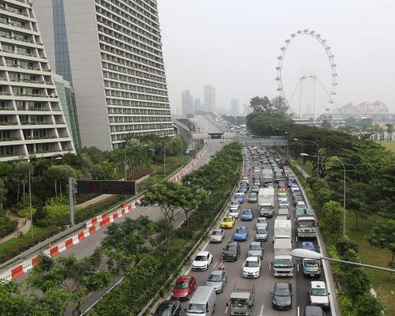
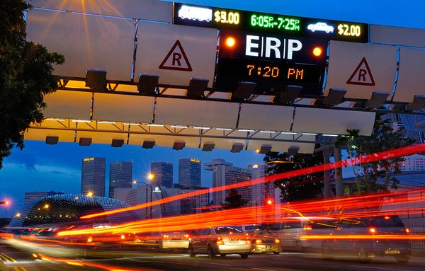
Introduction

Slide 3
Analysis
According to the traffic history data from LTA, and weather data from NEA, the main causes of the traffic jam:
Weather conditions
Temporal Analysis
Spatial
Accidents

Slide 4
EPN
EPA1: Pattern - Temporal
Output
EPA5: Translate
Output
road category = C/B &
previous speed band = 2 &
current speed band = 1
message =“Major Jam at RoadName
Not Selected
Failure
EP1
Traffic Speed Bands
Channel1
EPA3: Pattern - Temporal
Output
EPA6: Translate
Output
EC1
road category = C/B &
previous speed band = 3 &
current speed band = 2
message = “Traffic building at” Roadname. “Consider alternatives”
Not Selected
Failure
EPA3: Pattern - Spatial
Output
EPA6: Translate
Output
EP2
road category = C/B &
current speed band = 2/3 &
Forecast in area =HG/HR/HS/HT
message = “Heavy Rain expect in” Area. Drive with caution”
NEA 2-hr NowCast
Not Selected
Failure
EP3
Filter In
EPA6: Translate
Output
Traffic Incidents
EPA3: Filter
Type = accident/vehicle breakdown/unattended vehicle
Filter Out
message = “Heavy Rain expect in” Area. Drive with caution”
Failure

Slide 5
Evaluation
Based on the analysis, we

Slide 6
Demo

Slide 7
Questions

